Slide 1
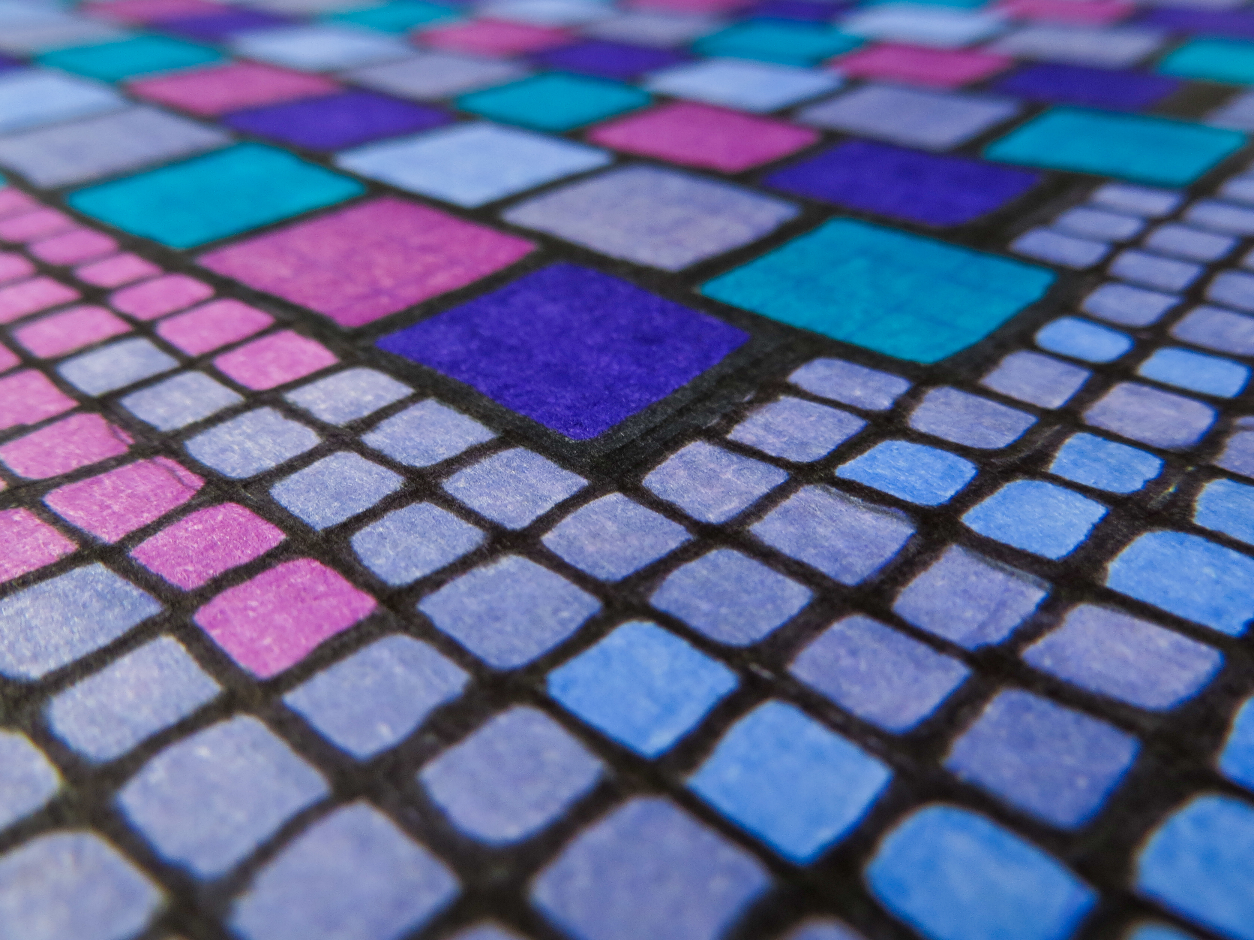
CSS Grid Layout
2016-12-17 @大漠 . #CSSConf
https://www.flickr.com/photos/19139526@N00/8331063530/

Slide 2
大漠
伪前端，就职于淘宝

Slide 3




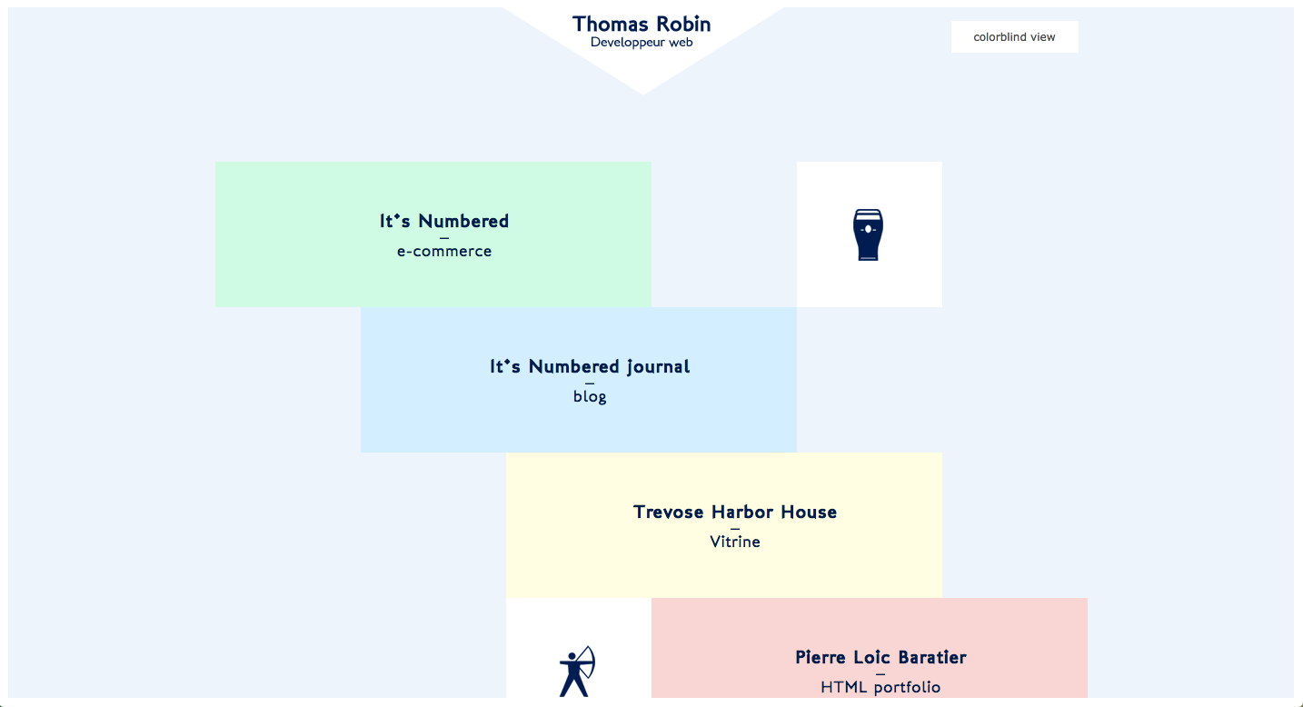

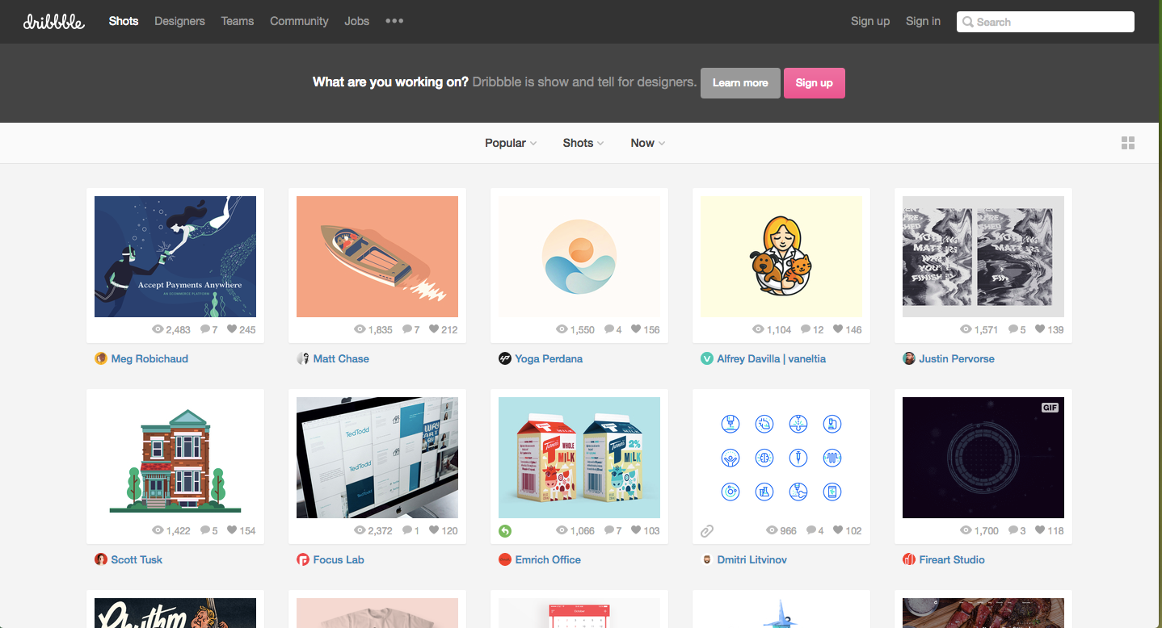
Notes:
现在大量网页设计基于网格布局。虽说人们通常注意不到它，但杂乱无章的布局时代确实已经过去了，现在是整齐结构化的天下。无论从理论、美学和整齐来说，这样的布局都很好平衡。网格结构是所有现代网站的基础，它总能给最终用户完美无暇的设计。

Slide 4
古老的table布局

Slide 6

现代Web布局
Float
inline-block
display: table
position (absolute 或 relative)
Frameworks(很多Frameworks)

Slide 7
希望的Web布局
Flexbox (https://drafts.csswg.org/css-flexbox)
CSS Grid Layout (https://drafts.csswg.org/css-grid)
Box Alignment (https://drafts.csswg.org/css-align)

Slide 8
CSS Grid System

Slide 9
http://960.gs/

Slide 10
Grid System

Slide 11



Grid 计算公式
cs = 1 => cw = (scw * cs) + (m * (cs – 1)) = 80 * 1 + 20 * (1 - 1) = 80
cs = 2 => cw = (scw * cs) + (m * (cs – 1)) = 80 * 2 + 20 * (2 - 1) = 180
cs = 3 => cw = (scw * cs) + (m * (cs – 1)) = 80 * 3 + 20 * (3 - 1) = 280
cs = 4 => cw = (scw * cs) + (m * (cs – 1)) = 80 * 4 + 20 * (4 - 1) = 380
cs = 5 => cw = (scw * cs) + (m * (cs – 1)) = 80 * 5 + 20 * (5 - 1) = 480
cs = 6 => cw = (scw * cs) + (m * (cs – 1)) = 80 * 6 + 20 * (6 - 1) = 580
cs = 7 => cw = (scw * cs) + (m * (cs – 1)) = 80 * 7 + 20 * (7 - 1) = 680
cs = 8 => cw = (scw * cs) + (m * (cs – 1)) = 80 * 8 + 20 * (8 - 1) = 780
cs = 9 => cw = (scw * cs) + (m * (cs – 1)) = 80 * 9 + 20 * (9 - 1) = 880
cs = 10 => cw = (scw * cs) + (m * (cs – 1)) = 80 * 10 + 20 * (10 - 1) = 980
cs = 11 => cw = (scw * cs) + (m * (cs – 1)) = 80 * 11 + 20 * (11 - 1) = 1080
cs = 12 => cw = (scw * cs) + (m * (cs – 1)) = 80 * 12 + 20 * (12 - 1) = 1180
固定网格计算
网格容器总宽度 1180
网格间距m = 20
网格列数mc = 12
scw = (容器宽度 – (m * (mc – 1))) / mc
cw = (scw * cs) + (m * (cs – 1))
scw：指的是单列宽度
m：指的是列间距
mc：最大列数（一般是12）
cw：列宽度
cs：列数(1~12)
scw = (容器宽度 – (m * (mc – 1))) / mc
scw = (1180 - (20 * (12 - 1))) / 12
scw = 80
cw = (scw * cs) + (m * (cs – 1))

Slide 12

[class*="m--"]{
padding-right: $gutter;
padding-left: $gutter;
@for $i from 1 through 12 {
&.m--#{$i} {
width: (80 * $i + 20 * ($i - 1)) * 1px;
}
}
}
http://codepen.io/airen/full/rMEggR/

Slide 13


Grid 计算公式
cs = 1 => cw = (scw * cs) + (m * (cs – 1)) = 6.86667% * 1 + 1.6% * (1 - 1) = 6.86667%
cs = 2 => cw = (scw * cs) + (m * (cs – 1)) = 6.86667% * 2 + 1.6% * (2 - 1) = 15.33333%
cs = 3 => cw = (scw * cs) + (m * (cs – 1)) = 6.86667% * 3 + 1.6% * (3 - 1) = 23.8%
cs = 4 => cw = (scw * cs) + (m * (cs – 1)) = 6.86667% * 4 + 1.6% * (4 - 1) = 32.26667%
cs = 5 => cw = (scw * cs) + (m * (cs – 1)) = 6.86667% * 5 + 1.6% * (5 - 1) = 40.73333%
cs = 6 => cw = (scw * cs) + (m * (cs – 1)) = 6.86667% * 6 + 1.6% * (6 - 1) = 49.2%
cs = 7 => cw = (scw * cs) + (m * (cs – 1)) = 6.86667% * 7 + 1.6% * (7 - 1) = 57.66667%
cs = 8 => cw = (scw * cs) + (m * (cs – 1)) = 6.86667% * 8 + 1.6% * (8 - 1) = 66.13333%
cs = 9 => cw = (scw * cs) + (m * (cs – 1)) = 6.86667% * 9 + 1.6% * (9 - 1) = 74.6%
cs = 10 => cw = (scw * cs) + (m * (cs – 1)) = 6.86667% * 10 + 1.6% * (10 - 1) = 83.06667%
cs = 11 => cw = (scw * cs) + (m * (cs – 1)) = 6.86667% * 11 + 1.6% * (11 - 1) = 91.53333%
cs = 12 => cw = (scw * cs) + (m * (cs – 1)) = 6.86667% * 12 + 1.6% * (12 - 1) = 100%
流体网格计算
网格容器总宽度 100%
网格间距m = 1.6%
网格列数mc = 12
scw = (100% – (m * (mc – 1))) / mc
cw = (scw * cs) + (m * (cs – 1))
scw：指的是单列宽度
m：指的是列间距(1.6%)
mc：最大列数（一般是12）
cw：列宽度
cs：列数(1~12)
scw = (容器宽度 – (m * (mc – 1))) / mc
scw = (100% - (1.6% * (12 - 1))) / 12
scw = 6.86666666667%
cw = (scw * cs) + (m * (cs – 1))

Slide 14
[class*="m--"]{
&:not(:first-child){
margin-left: $gutter;
}
@for $i from 1 through 12 {
&.m--#{$i} {
width: (6.86666666667 / 100 * $i + 1.6 / 100 * ($i - 1)) * 100%;
}
}
}
http://codepen.io/airen/full/dpBBYX/

Slide 15


CSS变量创建Grid
.container {
max-width: 1140px;
margin: 3em auto;
padding: var(--gutter);
}
.row{
display: flex;
flex-wrap: wrap;
margin: 0 calc(var(--gutter) - ( var(--gutter) * 2) ) 20px;
}
[class*="m--"]{
padding-right: calc(var(--gutter));
padding-left: calc(var(--gutter));
flex-basis: calc((100% / var(--columns)) * var(--column-width));
@for $i from 1 through 12 {
&.m--#{$i} {
--column-width: $i;
}
}
}
:root{
--color: #0C3934;
--bg: #F8EBEE;
/* Grid */
--gutter: 10px; /*列间距*/
--columns: 12; /*列数*/
}

Slide 16
http://www.w3cplus.com/css3/create-css-grid-system-with-css-variables.html
http://codepen.io/airen/full/jMjvON/

Slide 17
Grid Frameworks
Susy
960gs
BootStrap Grid
Zen Grids
…

Slide 18
CSS Grid Layout

Slide 19
CSS Grid Layout 发展过程
2010年由微软提出，最早在IE10实施
2011年4月首次公开草案
2015年3月2日Chrome支持
2016年9月29日成为W3C候选标准

Slide 20
Grid 术语

Slide 21
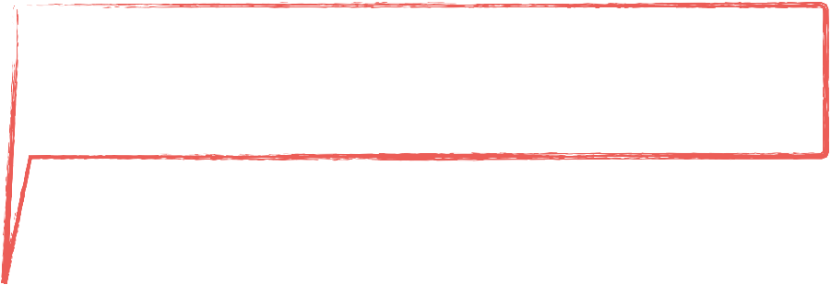




网格容器和网格项目
a
display: grid | inline-grid
<div class="container">
<div class="item item-1"></div>
<div class="item item-2"></div>
<div class="item item-3"></div>
</div>
网格项目

Slide 22
网格线
grid-template-columns: 300px 200px 100px;
grid-template-rows: 100px 50px;

Slide 23
网格轨道

Slide 24
网格单元格

Slide 25
网格区域

Slide 26
网格间距

Slide 27
定义网格

Slide 28
grid-template-columns: 300px 200px 100px;
grid-template-rows: 100px 50px;

Slide 29
.cards {
display: grid;
}
http://codepen.io/airen/full/woyoxz/

Slide 30
.cards {
display: grid;
grid-template-columns: 33.33% 33.33% 33.33%;
grid-template-rows: 200px 200px 200px;
}
http://codepen.io/airen/full/MbQbqQ/

Slide 31
.cards {
display: grid;
grid-template-columns: 33.33% 33.33% 33.33%;
grid-template-rows: 200px 200px 200px;
grid-gap: 20px;
}
http://codepen.io/airen/full/gLvLZr/

Slide 32
.cards {
display: grid;
grid-template-columns: 1fr 1fr 1fr;
grid-template-rows: 200px 200px 200px;
grid-gap: 20px;
}
http://codepen.io/airen/full/woyoZJ/

Slide 33
.cards {
display: grid;
grid-template-columns: 500px 1fr 2fr;
grid-template-rows: 200px 200px 200px;
grid-gap: 20px;
}
http://codepen.io/airen/full/NbybVg/

Slide 34
.cards {
display: grid;
grid-template-columns: 1fr 1fr 1fr;
grid-template-rows: 200px 200px 200px;
grid-gap: 20px;
}
http://codepen.io/airen/full/woyoZJ/

Slide 35
.cards {
display: grid;
grid-template-columns: repeat(3, 1fr) ;
grid-template-rows: 200px 200px 200px;
grid-gap: 20px;
}
http://codepen.io/airen/full/GNQNbZ/

Slide 36
.cards {
display: grid;
grid-template-columns: repeat(3, 1fr) ;
grid-template-rows: 200px 200px 200px;
grid-gap: 20px;
}
http://codepen.io/airen/full/YpepmX/

Slide 37
.cards {
display: grid;
grid-template-columns: repeat(3, 1fr) ;
grid-auto-rows: 200px;
grid-gap: 20px;
}
http://codepen.io/airen/full/aBqpbx/

Slide 38
.cards {
display: grid;
grid-template-columns: repeat(auto-fill, 200px) ;
grid-gap: 20px;
}
http://codepen.io/airen/full/aBqpbx/

Slide 39
.cards {
display: grid;
grid-template-columns: repeat(auto-fill, 200px) ;
grid-gap: 20px;
}
http://codepen.io/airen/full/aBqpbx/

Slide 40
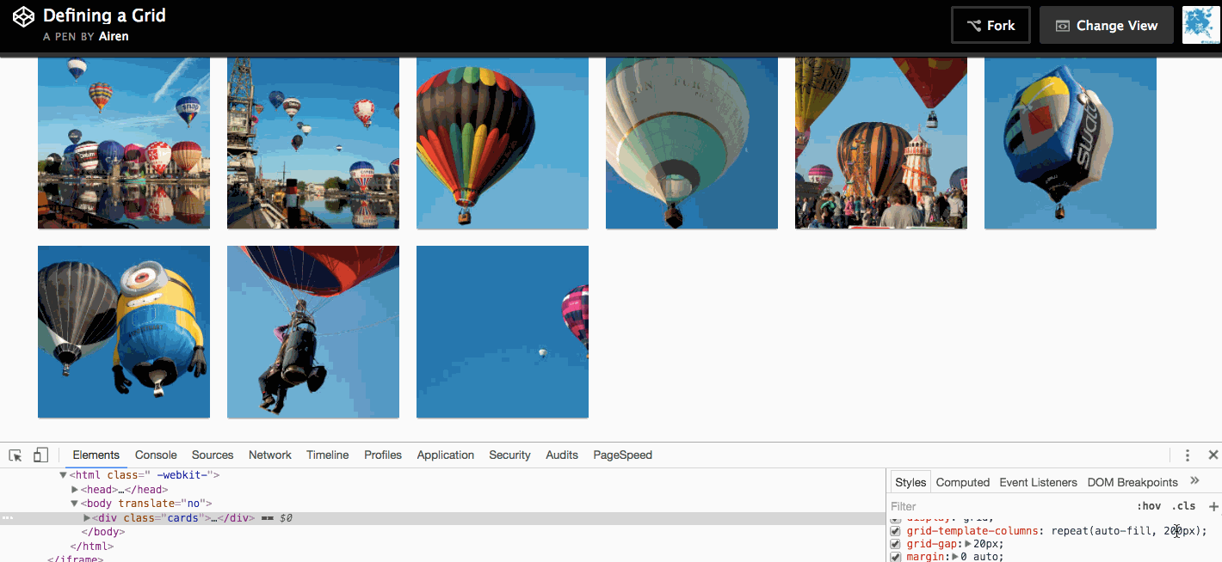
http://codepen.io/airen/full/aBqpbx/

Slide 41
.cards {
display: grid;
grid-template-columns:
repeat(auto-fill, minmax(200px,1fr)) ;
grid-gap: 20px;
}
http://codepen.io/airen/full/ObQWNm/

Slide 42
.cards {
display: grid;
grid-template-columns:
repeat(auto-fill, minmax(200px,1fr)) ;
grid-gap: 20px;
}
http://codepen.io/airen/full/ObQWNm/

Slide 43
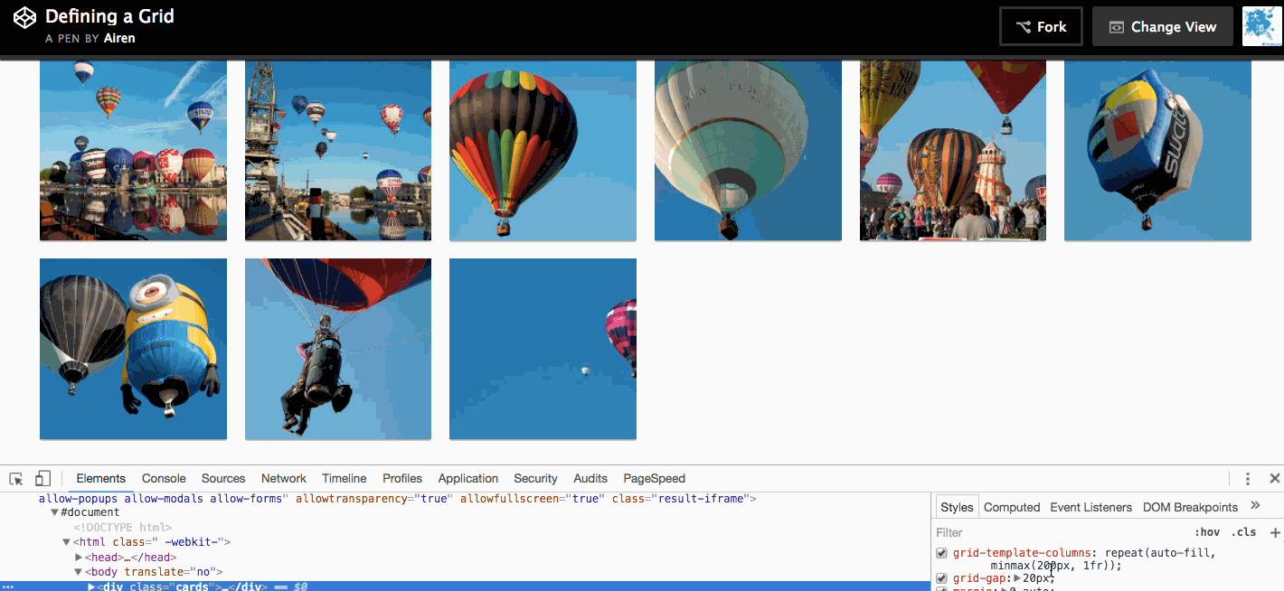
http://codepen.io/airen/full/ObQWNm/

Slide 44
.card:nth-child(1) {
grid-column-start: 2;
grid-column-end: 4;
grid-row-start: 1;
grid-row-end: 3;
}
http://codepen.io/airen/full/Nbydjy/

Slide 45
.card:nth-child(1) {
grid-column: 2 / 4;
grid-row: 1 / 3;
}
http://codepen.io/airen/full/LbQxjp/

Slide 46
.card:nth-child(1) {
grid-area: 1 / 2 / 3 / 4;
/*grid-area: grid-row-start / grid-column-start / grid-row-end / grid- column-end*/
}
http://codepen.io/airen/full/WoMREJ/

Slide 47
.cards {
display: grid;
grid-template-columns:
[side-start] 1fr
[main-start] 1fr
1fr [main-end];
grid-template-rows:
[main-start] 200px
200px [main-end];
grid-gap: 20px;
}
.card:nth-child(1) {
grid-column:
main-start / main-end;
grid-row:
main-start / main-end;
}
http://codepen.io/airen/full/ZBrLaP/

Slide 48
.cards {
display: grid;
grid-template-columns:
[side-start] 1fr
[main-start] 1fr
1fr [main-end];
grid-template-rows:
[main-start] 200px
200px [main-end];
grid-gap: 20px;
}
.card:nth-child(1) {
grid-area: main;
}
http://codepen.io/airen/full/ENQZLx/

Slide 49
.cards {
display: grid;
grid-template-columns:
repeat(3, 1fr);
grid-template-rows:
200px 200px;
grid-template-areas:
”side1 main main”
”side2 main main”;
grid-gap: 20px;
}
.card:nth-child(1) {
grid-area: main;
}
.card:nth-child(4) {
grid-area: side1;
}
.card:nth-child(8) {
grid-area: side2;
}
http://codepen.io/airen/full/MbQJGx/

Slide 50
A 12 column, flexible grid

Slide 51
<!-- Stack the columns on mobile by making one full-width and the other half-width -->
<div class="row">
<div class="col-xs-12 col-md-8">.col-xs-12 .col-md-8</div>
<div class="col-xs-6 col-md-4">.col-xs-6 .col-md-4</div>
</div>
<!-- Columns start at 50% wide on mobile and bump up to 33.3% wide on desktop -->
<div class="row">
<div class="col-xs-6 col-md-4">.col-xs-6 .col-md-4</div>
<div class="col-xs-6 col-md-4">.col-xs-6 .col-md-4</div>
<div class="col-xs-6 col-md-4">.col-xs-6 .col-md-4</div>
</div>
<!-- Columns are always 50% wide, on mobile and desktop -->
<div class="row">
<div class="col-xs-6">.col-xs-6</div>
<div class="col-xs-6">.col-xs-6</div>
</div>
BootStrap Grid: http://getbootstrap.com/css/#grid

Slide 52
BootStrap Grid: http://getbootstrap.com/css/#grid

Slide 54
.wrapper {
display: grid;
}
http://codepen.io/airen/full/bBLgOj/

Slide 55
.wrapper {
display: grid;
grid-template-columns: repeat(12, [col] 1fr);
grid-template-rows: repeat(5, [row] auto);
grid-column-gap: 1em;
grid-row-gap: 15px;
}
http://codepen.io/airen/full/aBqpxd/

Slide 56
.header {
grid-column: col / span 12;
grid-row: 1;
}
.box1 {
grid-column: col / span 4;
grid-row: row 2;
}
http://codepen.io/airen/full/KNQaYE/

Slide 57
.box1 {
grid-column: col / span 4;
grid-row: row 2 / span 2;
}
.box2 {
grid-column: col 5 / span 4;
grid-row: row 2 / span 3;
}
http://codepen.io/airen/full/WoMRVL/

Slide 58
.container {
display: grid;
grid-template-columns: repeat(12, [col] 1fr);
grid-column-gap: 1em;
grid-row-gap: 15px;
}
[class*=“col”]:nth-of-type(n+1):nth-of-type(-n+12){ grid-column: span;}
[class*=“col”]:nth-of-type(n+13):nth-of-type(-n+18){ grid-column: span 2;}
http://codepen.io/airen/full/MbQpKW/

Slide 59
Grid and Box Alignment Module

Slide 60
.wrapper {
display: flex;
}
.wrapper li {
min-width: 1%;
flex: 1 0 25%;
}
.wrapper li:nth-child(2) {
align-self: center;
}
.wrapper li:nth-child(3) {
align-self: flex-start;
}
.wrapper li:nth-child(4) {
align-self: flex-end;
}
http://codepen.io/airen/full/PbQpmy/

Slide 61
.wrapper {
display: grid;
grid-template-columns:
repeat(4, fr);
}
.wrapper li:nth-child(2) {
align-self: center;
}
.wrapper li:nth-child(3) {
align-self: start;
}
.wrapper li:nth-child(4) {
align-self: end;
}
http://codepen.io/airen/full/NbypvV/

Slide 62
Flexbox Layout Or Grid Layout?

Slide 63
Flexbox Layout定义一个维度，行或者列
Grid Layout定义两个维度，行和列

Slide 64

http://www.w3cplus.com/css3/solving-problems-with-css-grid-and-flexbox-the-card-ui.html
http://codepen.io/airen/full/qqxrxP/

Slide 65
待续...

Slide 66
相关资料
Grid规范: https://www.w3.org/TR/css-grid-1
Box Alignment规范：https://www.w3.org/TR/css-align-3
Flexbox规范: https://www.w3.org/TR/css-flexbox-1
Flexbox教程:http://www.w3cplus.com/blog/tags/157.html
Grid教程：http://www.w3cplus.com/blog/tags/355.html
Grid案例：http://codepen.io/collection/XmZoNW
Github：https://github.com/airen/grid-layout
Grid更多资源：http://gridbyexample.com/

Slide 67
THANK YOU

Slide 68











